Slide 1
Automatic transmission
Jiwoo, Jayo and Michael

Slide 2
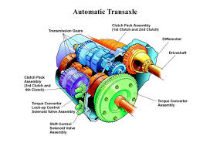
Introduction to Automatic Transmission
Automatic transmission is a type of transmission used in motor vehicles that automatically changes gears while the vehicle is in motion.
The goal of automatic transmission is to make driving easier and more comfortable for the driver by eliminating the need for manual gear shifting.

Slide 3
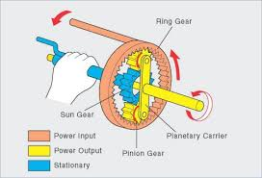
How Automatic Transmission Works
Imagine you have a toy car that you can push along the ground. The faster you push it, the faster it goes. Now imagine that you have a second toy car that is connected to the first car by a rubber band. If you push the first car, the rubber band will stretch and start to turn the second car. The faster you push the first car, the faster the second car will turn.

Slide 4
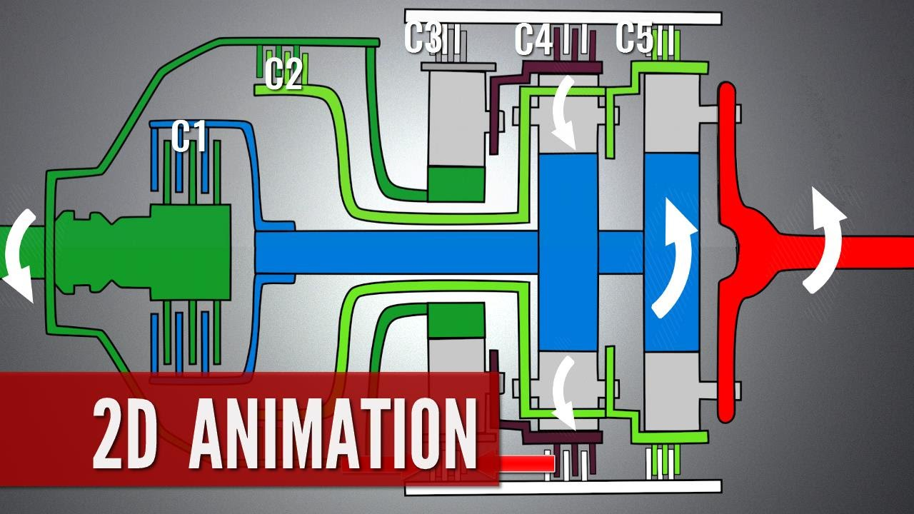
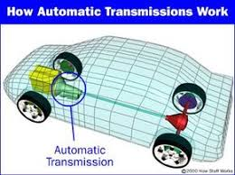
How Automatic Transmission Works
An automatic transmission works in a similar way. It has a series of gears that are connected to each other by a fluid. When the engine turns, it spins the fluid. This fluid then spins the gears, which turns the wheels of the car. The faster the engine turns, the faster the gears spin, and the faster the car goes.

Slide 5
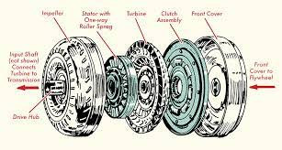
How Automatic Transmission Works
The automatic transmission also has a device called a torque converter. The torque converter is like the rubber band in the analogy. It helps to transfer power from the engine to the gears, even when the car is not moving. This is why you can start driving a car with an automatic transmission without having to rev the engine.

Slide 6
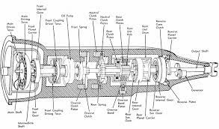
How Automatic Transmission Works
The automatic transmission is a very complex piece of machinery, but it works in a very simple way. It uses a series of gears and a fluid to transfer power from the engine to the wheels of the car. This allows you to drive your car without having to shift gears manually.

